Slide 1
JFK: What Really Happened?

Slide 2
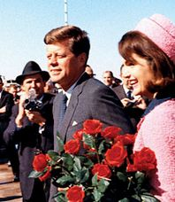
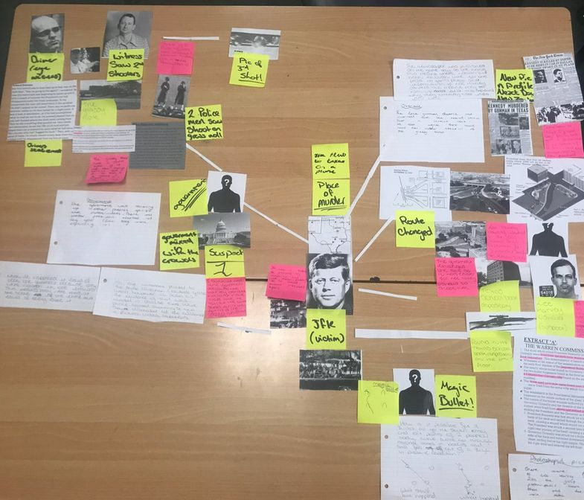
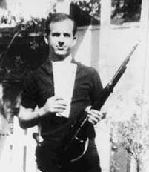
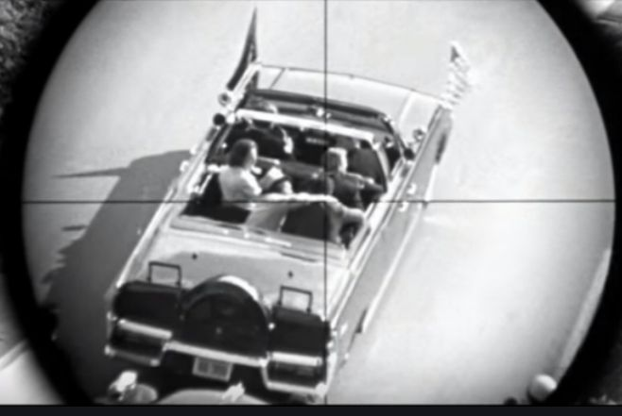

Slide 4
John Fitzgerald Kennedy
War Hero
Loved by the people
Enemies
Mafia
CIA
Military Leaders
Ex Cubans
USSR

Slide 5
Lee Harvey Oswald
Former marine (1,4,5)
Compassionate discharge (1,4,5)
Defected to USSR
Married Russian woman -
Returned to US after 2 ½ years
Two children
Separated from wife
Worked at TSBD
Owned a Caracano rifle
Was seen carrying a bag 24”-36” long into work that day

Slide 6
November 22, 1963 – Daeley Plaza
Three shots fired from TSBD
Building searched (1 hour)
Oswald missing
Had gone to his boarding house
Oswald's picture circulated
Oswald spotted 15 mins later by police officer
Oswald shot police officer with pistol and ran to the Texas Theatre
1:50 Oswald arrested
Oswald claimed innocence, said he was a "patsy“
LB Johnson became president
Two days later while Oswald was being moved, he was shot by Jack Ruby

Slide 7
Notes:
1 Houston Street 2) Window Sill 3) Elm Street 4) Grassy Knoll 5) Triple Underpass 6) Oak Cliff 7) Federal building annex

Slide 8
Investigations
Warren Commission 1964 (10 months)
No conspiracy
888 pages
House Select Committee on Assassinations (1976)
Possible second shooter
Dictabelt recording suggested 4 bullets (validity questioned afterward)
National Archives and Records Administration
Required to release all documents
Last minute redactions at the request of the CIA and FBI

Slide 9
Resources
Assassination of John F. Kennedy, Jeff Wallenfeldt, Sept. 6, 2019, Encyclopedia Brittanica, https://www.earthcam.com/usa/texas/dallas/dealeyplaza/?content=about
Dealey Plaza Cam, Earth Cam, https://www.earthcam.com/usa/texas/dallas/dealeyplaza/?content=about
Episode 121 – The Primer, The Lone Gunman Podcast, https://www.spreaker.com/user/thelonegunman/ep-121-the-primer
Miss Griffith-Evans 29 Jan 2018, https://twitter.com/hashtag/crimeboards
Saudis Uncover New Evidence that JFK Died in a Fistfight with Lee Harvey Oswald, Situation Theatre, http://situationtheatre.com/news-fuse/jfk-died-in-a-fistfight

